Slide 1
Data Structures and Comprehensions
Adv. Python Programming – Module 6

Slide 2
Lists and Tuples
Adv. Python Programming

Slide 3
What are lists?
Most versatile and heavily used data structure in Python
A list is ordered, mutable and can hold mixed data types
Create a list by using square brackets – [ ]
Data is separated by commas when hard coding those
Elements in a list are at numbered indexes
must be integer (whole number)
Use negative indexes to start from the end
To change an element you access the index and set a new value
Can also replace multiple items at once using slicing
fruits = ["apple", "banana", "cherry"]
print(fruits[0]) # apple print(fruits[1]) # banana print(fruits[2]) # cherry
print(fruits[-1]) # cherry (last item) print(fruits[-2]) # banana (second-to-last)
fruits[1] = "blueberry" print(fruits) # ['apple', 'blueberry', 'cherry’]
numbers = [1, 2, 3, 4, 5] numbers[1:4] = [20, 30] print(numbers) # [1, 20, 30, 5]

Slide 4
List Slices
If you want to extract a portion of a list you can use list slicing
use square brackets and put start and end index – [start : end]
If you leave start blank it will start at the beginning – 0
If you leave end blank it will go to the last element in the list
You can also setup how must to “step” by or which elements to go through
[start:stop:step] – similar to range() in for loops
letters = ["a", "b", "c", "d", "e"]
print(letters[1:4]) # ['b', 'c', 'd'] print(letters[:3]) # ['a', 'b', 'c’]
#(start assumed 0) print(letters[2:]) # ['c', 'd', 'e’]
#(go to end)
print(letters[::-1])
# ['e', 'd', 'c', 'b', 'a']

Slide 5
Looping and Membership
We already pretty much know this, but do we understand it?
Two ways to loop through a list
for each style loop
Loop directly over values in the list
Great for accessing values and printing
Can’t necessarily change values (unless we have elements as an object)
index based loop
create a counter variable using the range() function and len() of the list
Then use the counter variable in square brackets
Can access values, used to print BUT the major thing here is modifying the value at a index location
In the same wheelhouse is checking membership – or is an element in a list
for fruit in fruits: print(fruit)
for i in range(len(fruits)): print(f"Index {i} has {fruits[i]}")
if "apple" in fruits: print("We have apples in stock.")

Slide 6
Methods of Lists
append(x) – add an item to the end
insert(i, x) – insert an item at a specific index
extend(iterable) – add all items from another sequence
remove(x) – remove the first occurrence of a value
pop(i) – remove and return the item at index i (defaults to last)
clear() – remove all items from the list
sort() – sort the list in place
reverse() – reverse the list in place
count(x) – count how many times x appears
index(x) – find the index of x (raises an error if missing)

Slide 7
Concatenating and Repeating Lists
You can combine two lists to make a new one
You can use the * operation to repeat elements in a list upon creation
a = [1, 2, 3] b = [4, 5] combined = a + b print(combined) # [1, 2, 3, 4, 5]
greeting = ["Hello"] triple = greeting * 3 print(triple)
# ['Hello', 'Hello', 'Hello']

Slide 8
2-Dimensional lists
Simply a list whose elements are themselves a list – list inside a list
You can technically have as many dimensions as you want but typically you see 2
Natural fit for table like data
Depending on what you are doing an object may be a better fit
Use nested loops to loop through a 2D list
expenses = [ [1854.32, 2991.87], [1023.45, 2210.78, 2876.14], [1345.99, 1987.55, 2100.10, 2999.88],
[1765.43, 2440.12] ]
total = 0 for r in range(len(expenses)):
for c in range(len(expenses[r])): total += expenses[r][c]
for row in expenses:
for column in row:
total += column

Slide 9
Rectangle 2D List – known data
If you know the layout of a 2D list it may not require a nested loop structure
Sometimes you can use a for loop and hard code each column you are accessing.
inventory_table = [ ["Vacuum Bags", 50, 12.99], ["Extension Hose", 20, 24.50], ["Filter Pack", 35, 9.75] ]
rows = len(inventory_table) for r in range(rows): name = inventory_table[r][0] qty = inventory_table[r][1] price = inventory_table[r][2] print(f"{name}: {qty} units at ${price:.2f}")

Slide 10


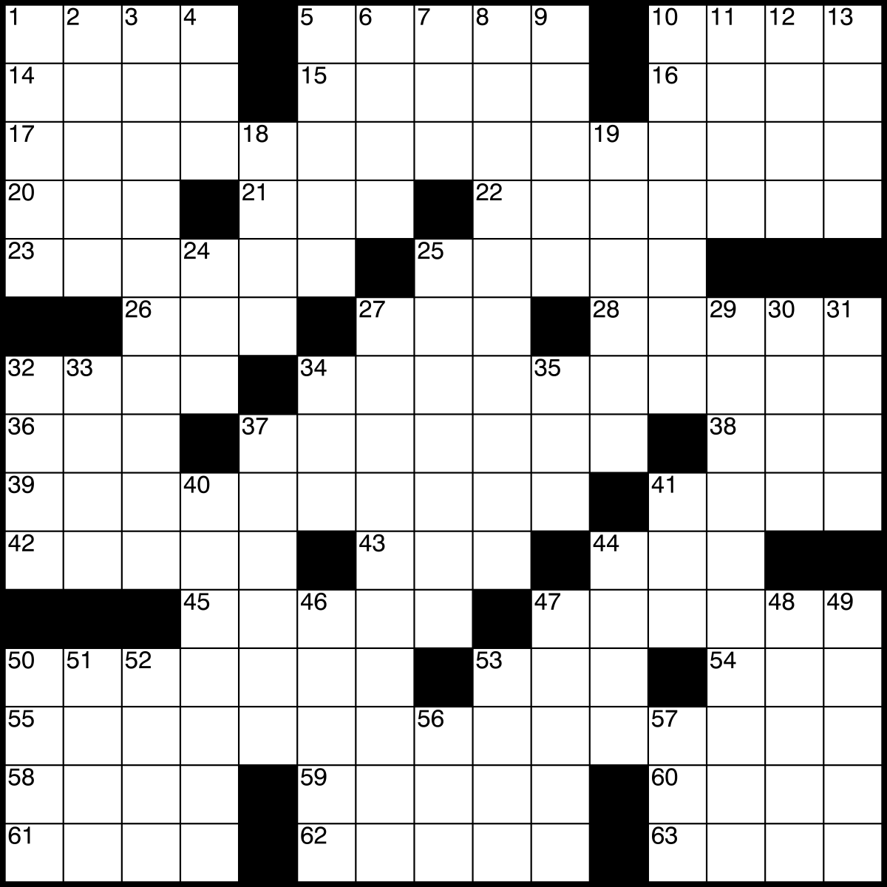
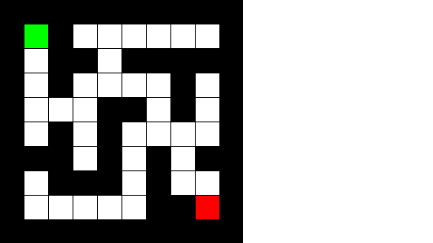
Other things for 2D lists

Slide 11
What are tuples?
Tuples are closely related to lists – ordered sequences of items
The key difference is that tuples are immutable
Once created they cannot be changed
Makes tuples safer to use when you want to guarantee that a collection of values will stay the same
Common uses
Representing coordinates like (x, y)
Representing fixed groups like RGB colors (red, green, blue)
Return multiple values from functions
Using them as dictionary keys (lists can’t be keys, tuples can)

Slide 12
Creating and Using Tuples
point = (3, 4) color = ("red", 255, 0)
print(point[0]) # 3 print(point[1]) # 4
coords = (10, 20, 30, 40) print(coords[1:3]) # (20, 30)
x = (5) # this is just the integer 5 x = (5,) # this is a tuple containing 5
def get_min_max(values): return (min(values), max(values)) low, high = get_min_max([5, 9, 2, 8])
You create tuples using parentheses()
Access them with square brackets
You can slice tuples
To create single value tuples, put in one value with a comma
When to choose tuples over lists?
You want to signal “this should not change”
You need to use the collection as a dictionary key
You are packaging multiple return values together

Slide 13
Dictionary and Sets
Adv. Python Programming

Slide 14
Dictionary Review
Lists are driven by position with index, dictionaries are unordered and use keys for reference
You can look up values using meaningful names or IDS instead of numeric positions
Perfect for representing objects like students, customers, configuration settings or anything with a label for the data
Keys are unique – can’t have twice
Provides fast lookups by key
student = { "name": "Ava", "age": 20, "major": "Computer Science" }
print(student["name"]) # Ava print(student["age"]) # 20
# student["gpa"] # KeyError: 'gpa'

Slide 15
Basic Dictionary Operations
If you know the key does exist use the square brackets for direct access
It is much safer to use the .get() method
It defaults a return a None if the key doesn’t exist
Or you can add in what you want to be the “none” return value
Adding/Updating a key is by using the square brackets[]
If the key already exists it updates, if it doesn’t it will add
To a delete a key, you can use the del() built into python, but can raise a KeyError if doesn’t exist
Safer to use the .pop() method which removes and returns the key
gpa = student.get("gpa") # None gpa = student.get("gpa", 0.0) # 0.0
student["gpa"] = 3.8 # add new key student["major"] = "Software Development" # update existing
del student["gpa"]
gpa = student.pop("gpa", None)

Slide 16
Helpful Methods and Looping Through
If you want to get views of your dictionary use the following
keys() – get view of the keys
values() – get view of values
items() – get (key, value) as view as tuples
Several ways to loop through dictionaries
Loop through using the key
Loop through just the keys
Loop over values
Loop over key and value pairs
print(student.keys()) # dict_keys([...]) print(student.values()) # dict_values([...]) print(student.items()) # dict_items([...])
for key in student: print(key, "=>", student[key])
for key in student.keys(): print("Key:", key)
for value in student.values(): print("Value:", value)
for key, value in student.items(): print(f"{key}: {value}")

Slide 17
Dictionary creation
To combine dictionaries using the vertical bar | operator for union
The dict() function can act as a constructor allowing you to define the key and set the value
You can also pass a list of key-value pairs
defaults = {"theme": "light", "autosave": True} user_settings = {"theme": "dark"} final_settings = defaults | user_settings print(final_settings) # {'theme': 'dark', 'autosave': True}
user = dict(name="Lucas", role="Instructor", active=True)
pairs = [("name", "Ava"), ("age", 20)] student2 = dict(pairs)

Slide 18
__dict__ dunder method
As discussed with object the dictionary method is built onto all python objects
It automatically converts objects into dictionaries using the variable names as fields and assigns their value
Great for JSON serialization discussed next chapter
We may also want to override it or create a separate method on objects so that we can hide some data
class Product: def __init__(self, name: str, price: float): self.name = name self.price = price p = Product("Vacuum", 199.99) print(p.__dict__)
# {'name': 'Vacuum', 'price': 199.99}

Slide 19
What are sets?
Sets are collections that store unique items without caring about order
You can think of them as a bag of distinct values
Excellent when you want to avoid duplicates, check membership quickly, or compare groups of items
To create sets you use curly brackets {} separated by a comma
Looks similar to dictionaries but there are no key-value pairs, just values
Because we use curly brackets for dictionaires you have to use the set() function to declare a blank set.
colors = {"red", "green", "blue"}
# This is an empty dictionary, NOT a set
empty = {}
# This creates an empty set empty_set = set()

Slide 20
Why Sets and Operations
Sets are particularly powerfully operation that sound like math operations with union, difference and intersections of items
Operations based on set “a” and set “b”
Union – all items that appear in “a” OR “b” (or both)
use a.union(b) OR a | b
Intersection – items that appear in both “a” and “b”
use a.intersection(b) or a & b
Difference – items in “a” that are not in “b”
use a.difference(b) or a - b
Symmetric difference – items in either “a” or “b” but not in both
use a.symmetric_difference(b) or a ^ b
warehouse_a = {"filter", "bag", "hose"} warehouse_b = {"bag", "belt", "brush"} both = warehouse_a & warehouse_b print("Both carry:", both) # {'bag'} all_items = warehouse_a | warehouse_b print("All unique items:", all_items) only_a = warehouse_a - warehouse_b print("Only in A:", only_a) different = warehouse_a ^ warehouse_b print("Not shared:", different)

Slide 21
Sets and Dictionaries with custom objects
In order to use custom objects in sets (for uniqueness) and as a dictionary key you need to make sure to have both the __eq__ and __hash__ methods overridden
We have already seen __eq__ where we choose what attributes to check for equality
But if you want to use in a set you must have __hash__ as well
This is a unique number created by the hash() from the same attributes used in __eq__
If both aren’t defined you can use in set or as a key in dictionary
class Product:
def __init__(self, name, price):
self.name = name
self.price = price
def __eq__(self, other):
return isinstance(other, Product)
and self.name == other.name
and self.price == other.price
)
def __hash__(self):
return hash((self.name, self.price))
p1 = Product("Bag", 9.99)
p2 = Product("Bag", 9.99)
items = {p1, p2}
print(len(items))
# 1, because p1 and p2 are considered equal

Slide 22
Converting Between Data Structures
Adv. Python Programming

Slide 23
Constructor function
You can convert from one data structure to the other
Some of these functions have been sprinkled throughout
list()
dict()
set()
tuple()
Why?
You may want the same information in one structure to perform like another
lists – order and indexing
set – for uniqueness and comparisons
dictionary – for keyed lookup
tuple – ordered but not be able to modify
s = {"apple", "banana", "cherry"} fruit_list = list(s)
student = {"name": "Ava", "age": 20} keys = list(student.keys()) values = list(student.values())
nums = [1, 2, 3] nums_tuple = tuple(nums)
items = ["pen", "pen", "pencil"] unique_items = set(items) # {'pen', 'pencil’}
pairs = [("name", "Lucas"), ("role", "Instructor")] info = dict(pairs) settings = dict(debug=True, version="1.0")

Slide 24
Python Function for Data Structures
Adv. Python Programming

Slide 25
Some functions
len() – returns number of elements in a collection
sum() – adds up numeric values in an iterable
expects numeric values will cause error if mixture of non numeric types
min() – finds smallest value in iterable
max() – finds the largest value in iterable
names = ["Ava", "Noah", "Mia"] print(len(names)) # 3
sales = [100.50, 230.75, 89.99] total = sum(sales)
temperatures = [72, 68, 75, 70] lowest = min(temperatures) highest = max(temperatures)

Slide 26
Sorting and Boolean Values
values = [5, 3, 9, 1] sorted_values = sorted(values)
print(values) # original unchanged print(sorted_values) # [1, 3, 5, 9]
sorted_desc = sorted(values, reverse=True)
flags = [False, False, True] print(any(flags)) # True
errors = [False, user_input_invalid, file_missing] if any(errors): print("There was at least one error.")
checks = [True, True, True] print(all(checks)) # True
password_ok = len(password) >= 8 has_number = any(ch.isdigit() for ch in password) has_upper = any(ch.isupper() for ch in password) if all([password_ok, has_number, has_upper]): print("Password meets all requirements.")
sorted() takes any iterable and returns a new list with elements in sorted order
Remember objects you will want to define dunder comparison methods for what field to sort
Different from .sort() which sorts original iterable
set “reverse” property to True if you want to reverse
any() returns True if at least one element in the iterable is Boolean value of True
useful if you want to know if “any problem exists” when tracking those via a boolean
all() returns True if every element is True
helpful when validating that everything is in a good state when tracking via a boolean

Slide 27
Coding Example – Bank Account Updates
Add in an owner list – no repeated objects for sets
Add in eq and hash functions
Will now need to “search for owner” and if none exists then create new owner
Modify operations for Bank Accounts
Modify owners of accounts – add more than one.
Modify operations for owners – names, contact info, etc.

Slide 28
Comprehensions
Adv. Python Programming

Slide 29
What are comprehensions?
As your program grows, you will often find yourself writing loops that
build a new list based on an existing one
filter items according to some condition
transform values into a different shape
Python provides comprehensions as a concise way to express these patterns
A comprehension combines a loop and optional condition into a single expression
You can always still use loops, but comprehensions are often clearer for syntax reading
Think of these as “Take each item ‘x’ from this collection, maybe filter it, and build a new collection from the results.”

Slide 30
Core idea
If we take a traditional loop we can easily loop through and append it ot a list
But if we convert it to a comprehension we get a simple one line of code.
General pattern is:
squares = [] for n in range(1, 6): squares.append(n * n)
squares = [n * n for n in range(1, 6)]
[new_value_exp for item in iterable]

Slide 31
Filtering with comprehensions
If you want to filter out via a condition you can add in an if clause
Using a loop you have several lines
Using a comprehension you can put it all in one
Here is a real world example getting a list of active emails only if a ‘active’ attribute is True
evens = [] for n in range(20): if n % 2 == 0: evens.append(n)
evens = [n for n in range(20) if n % 2 == 0]
active_emails = [u.email for u in users if u.active]

Slide 32
Reducing a value (calculating)
Reducing means you calculate a value form a list
Like totally up a value
Min/Max of a value
Here we get a new list of just the prices of an object as a list, then send it to the sum() function
class Product:
def __init__(self, name, price):
self.name = name
self.price = price
items = [
Product("Pen", 1.50),
Product("Notebook", 4.25),
Product("Marker", 2.00)
]
total = sum([p.price for p in items])
# 7.75

Slide 33
Dictionary Comprehensions
You can also build dictionaries using comprehensions
Great for transforming keyed data
prices = {"apple": 1.50, "banana": 0.75, "cherry": 2.00} # apply 7% tax prices_with_tax = {name: price * 1.07 for name, price in prices.items()}

Slide 34
Set Comprehensions
Same as we do with lists except we don’t use square brackets
Use curly brackets to wrap the comprehension definition
words = ["hi", "hello", "hey", "hi"] unique_lengths = {len(word) for word in words}

Slide 35
When to use comprehensions
These aren’t required, you can always use for loops and append
However, they are great when you want to
Clearly show that you’re building a new collection
Perform simple transformations or filtering in one place
Keep code compact without sacrificing clarity
If the logic is simple and fits on one readable line use a comprehension
If the logic is complex or involves many steps use a regular loop
Comprehensions are one of the “Pythonic” tools unique to Python that separates it from other languages

Slide 36
Coding Example - Comprehensions
Additional Changes done:
Created a Transaction object, put this as a list on the bank account
Tracks debit and credits with dates and money spent/received.
Uses enum for type of transaction to look through all of one type.
Lots of things we can use comprehensions for
Filter through transactions using enumerations
Filter through transactions over timelines
Year
Month
Days/Week
Total up a list of transactions

